Slide 1
A Parallel Approach to Prime Number Generation: Comparative Analysis of Sieve-Based Algorithms
Viktor Kostadinoski∗, Vladimir Zdraveski∗
Faculty of Computer Science and Engineering, Skopje, Macedonia

Slide 2
Definitions: What is a Sieving Algorithm?
A sieving algorithm is a method for efficiently finding prime numbers by eliminating non-prime numbers from a list.
Sieve of Eratosthenes: A sieving algorithm that works by iteratively marking multiples of known primes as composite, leaving only the primes.
Sieve of Euler (Optimized Eratosthenes): Instead of marking all multiples, it only marks each composite number once, reducing redundant operations.
Time Complexity: O(N*log⁡(log⁡(N)))
Both algorithms are parallelizable, making them great candidates for optimization!

Slide 3
Motivation
Prime number generation is fundamental in cryptography, probabilistic primality tests (e.g., Miller-Rabin, AKS) and number theory
Traditional sieving algorithms (Eratosthenes, Euler) are efficient but sequential
Goal: Speed up prime generation using parallelization techniques
Challenge: Balancing parallelization overhead with performance gains
Key Questions:
❓ Will a parallel approach make prime generation faster using sieve algorithms?
❓ What is the optimal number of threads to balance overhead and speedup?

Slide 4
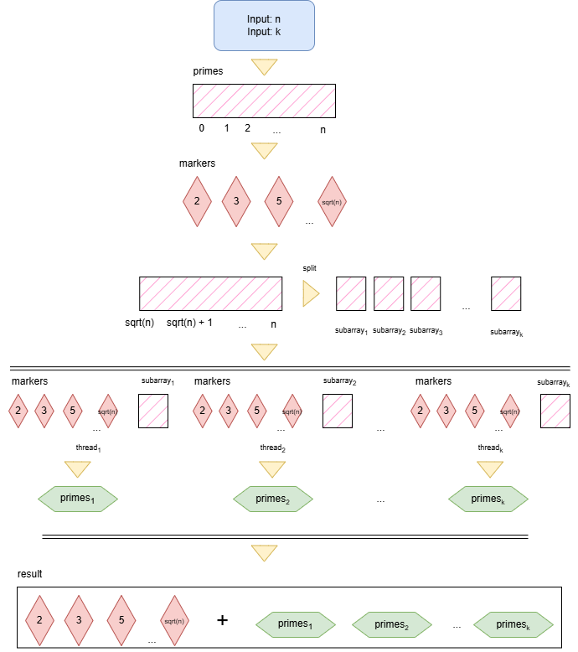
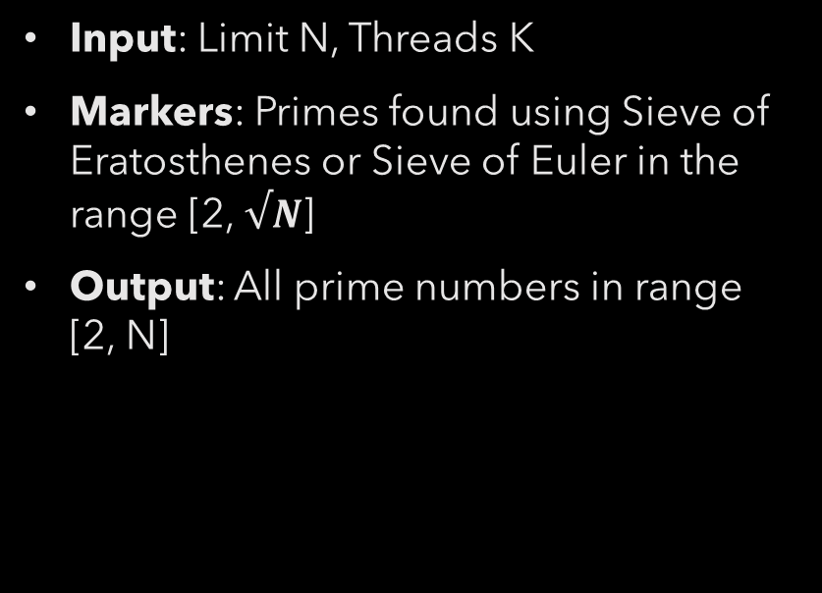
Solution Architecture
Input: Limit N, Threads K
Markers: Primes found using Sieve of Eratosthenes or Sieve of Euler in the range [2, $√N$]
Output: All prime numbers in range [2, N]

Slide 5

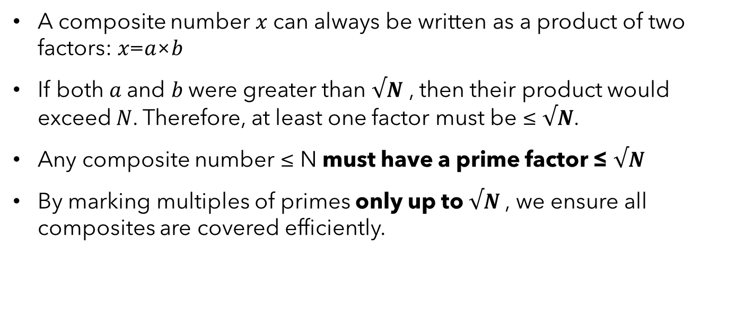
Why Compute Markers Only Up to $√N$
A composite number 𝑥 can always be written as a product of two factors: 𝑥=𝑎×𝑏
If both 𝑎 and 𝑏 were greater than $√N$ , then their product would exceed 𝑁. Therefore, at least one factor must be ≤ $√N$.
Any composite number ≤ N must have a prime factor ≤ $√N$
By marking multiples of primes only up to $√N$, we ensure all composites are covered efficiently.

Slide 6
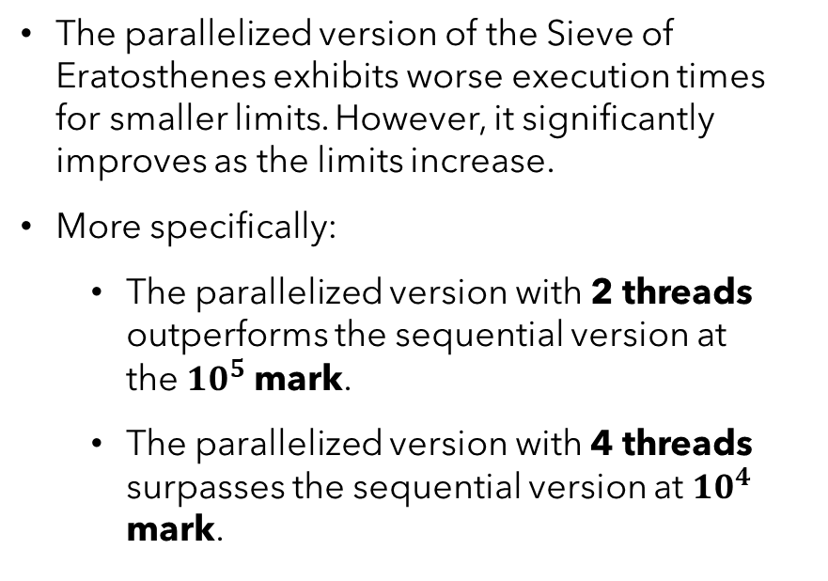
Results: Sieve of Eratosthenes
The parallelized version of the Sieve of Eratosthenes exhibits worse execution times for smaller limits. However, it significantly improves as the limits increase.
More specifically:
The parallelized version with 2 threads outperforms the sequential version at the${ 10}^{5}$ mark.
The parallelized version with 4 threads surpasses the sequential version at ${10}^{4}$ mark.

Slide 7
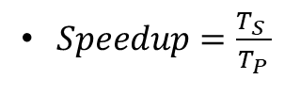
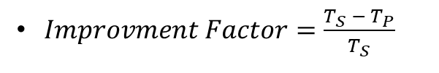
Results: Sieve of Eratosthenes
$Improvment Factor=\frac{T_{S} − T_{P}}{T_{S}}$
$Speedup=\frac{T_{S} }{T_{P}}$

Slide 8
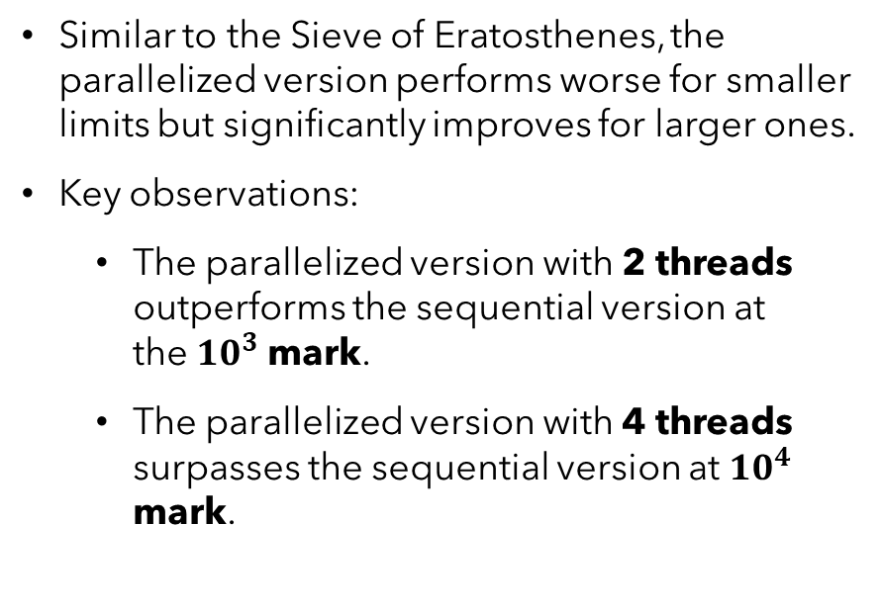
Results: Sieve of euler
Similar to the Sieve of Eratosthenes, the parallelized version performs worse for smaller limits but significantly improves for larger ones.
Key observations:
The parallelized version with 2 threads outperforms the sequential version at the${ 10}^{3}$ mark.
The parallelized version with 4 threads surpasses the sequential version at ${10}^{4}$ mark.

Slide 9
Results: Sieve of Euler
$Improvment Factor=\frac{T_{S} − T_{P}}{T_{S}}$
$Speedup=\frac{T_{S} }{T_{P}}$

Slide 10
Sieve of Eratosthenes vs Sieve of euler

Slide 11
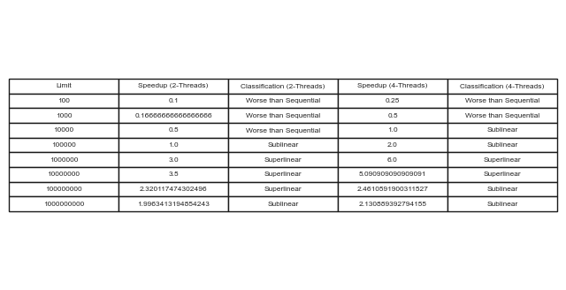
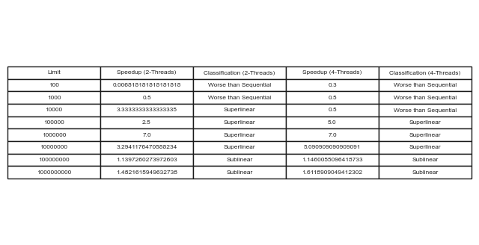


Sieve of Eratosthenes vs Sieve of euler
$\text{Sieve} \text{of} \text{Eratosthenes}$
$\text{Sieve} \text{of} \text{euler}$

Slide 12

Conclusion and Future Work
Conclusion:
Results align with expectations. Parallelization effectiveness is limited by sequential components (marker identification).
Speedup Trends: Slight superlinear speedup between ${ 10}^{5}$ and ${ 10}^{7}$ , then sublinear.
Stabilizes at ~2× speedup after ${ 10}^{7}$.
Optimal thread count: 2 threads due to increasing parallelization overhead.
For large limits (> ${ 10}^{7}$ ), parallelized sieves remain highly effective.
Future Work:
GPU-based parallelization for massive parallelism.
Hybrid sieving techniques combining Eratosthenes & Euler for improved efficiency.

Slide 13
Thank you for your attention!

